Slide 1


Financial Inclusion
and Social Well Being
Shona Alexander
Chief Executive

Slide 2

Background
Citizens Advice Newcastle is a local charity, set up in 1939, providing advice to people who live and work in the city. Most of our advice is provided by specially trained volunteers.
We have 2 core objectives:
To provide the advice people need for the problems they face.
To improve the policies and practices that affect people’s lives.

Slide 3
Principles of our service
Free: We don’t charge for any part of our service.
Independent: We act without bias or influence from outside bodies and always put the best interests of our clients first.
Confidential: We never pass on client details or even acknowledge that someone has used our service without their express permission.
Impartial: We do not judge anyone and our advice is made free from prejudice. Our service is open to everyone and we treat each client equally.

Slide 4





Key Enquiry Areas We Cover
Debt and Money Issues
Welfare Benefits and Tax Credits
Housing
Employment
Consumer
Family &
Relationships
Tax
Discrimination
Education
Immigration
And much more…

Slide 5
Our Top 5 Enquiries 2015 - 16

Slide 6
Benefits & tax credits | 6,763
Consumer goods & services | 444
Debt | 11,932
Education | 95
Employment | 1,228
Financial services & capability | 710
Health & community care | 250
Housing | 1,114
Immigration & asylum | 527
Legal | 754
Other | 562
Relationships & family | 849
Tax | 260
Travel & transport | 148
Utilities & communications | 764
Discrimination | 95
Total | 26,495

Slide 7
Top 10 Debt Issues Dealt with by Citizens Advice Newcastle in 2015-16
Debt Relief Order | 1,806
2. Council tax arrears | 1,507
3. Fuel debts | 955
4. Credit, store & charge card debts | 920
5. Unsecured personal loan debts | 857
6. Other | 626
7. Water supply & sewerage debts | 622
8. Telephone & broadband debts | 535
9. Bankruptcy | 463
Magistrate Court - fines & Compensation orders | 422

Slide 8

Money has a huge impact on our motional and social well-being
People make money decisions based on personal feelings – not always logical or sensible
We are heavily influenced by what other people do
Most people don’t think about the long term :
“money myopia”
Most people don’t like talking about their finances - more taboo even than religion, sex or politics

Slide 9


BBC Big Money Test Research surveyed 100,000 people
4 ways we see money:
Money as power and status - status spender
Money as generosity – generous indulger
Money as security – secure saver
Money as freedom - independence lover

Slide 10
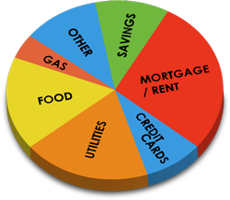
Why do people struggle with debt?
Worry all the time about how much you spend?
Buy things to make you feel better?
In denial about your spending habits?

Slide 11

Different types of debt
Credit - agreed, time-limited, repaid regularly and under control
Debt - money which has not been re-paid but can be managed
Problem debt - money which can’t be paid without major changes to circumstances / lifestyle

Slide 12

Acute problem debt - caused by sudden, unexpected or drastic changes to financial circumstances
Chronic problem debt - long term and successive debts, and “debtor mentality”
Poverty debt - long term dependency on welfare benefits, food banks and crisis support.

Slide 13

News Article
19 September 2016
Payday lender to cough up £35m in compensation to consumers after "serious failings" found by Financial Conduct Authority
Money Expert at uSwitch said “The FCA has clamped down on payday lenders, but it can’t make up for the emotional distress caused by the escalating debts.”

Slide 14
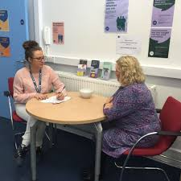
Tips for dealing with debt
Don’t ignore the problem – it won’t go away. The longer you leave it, the worse it gets.
Make the most of your income – check you are claiming all the benefits and tax credits you can. If you’ve lost your job, or are off work because you’re ill, check if any debts are covered by PPI.
Tackle your priority debts first – for example, debts that could mean losing your home, or having your gas or electricity cut off.

Slide 15
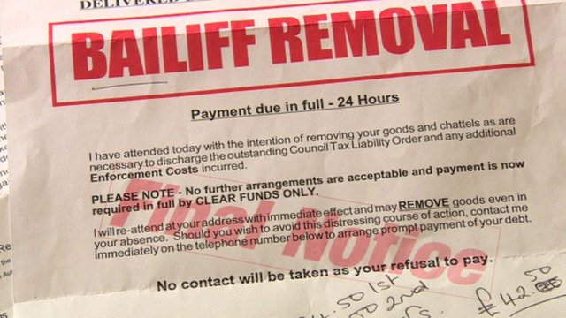
Work out your personal budget – show it to your creditors when you contact them.
Always keep copies of letters and papers you send or get.
Don’t borrow money to pay off your bills without thinking carefully. Get advice first - borrowing could lead to you losing your home.
Get advice from your local Citizens Advice or other independent advice service. If you are being taken to court, or bailiffs are involved, do this urgently. Fill in reply forms to court papers, and let the court have all the facts. Always go to court hearings and take your personal budget with you

Slide 16
Get in touch with your creditors straight away and explain your situation. Contact all of your creditors. If you arrange to pay some but not others, you may get into difficulty again. You do not need to offer payment straight away.
Work out a reasonable offer for each creditor. Don’t worry if the offer seems small. Creditors prefer a regular small amount more than an offer you can’t afford.
Don’t give up trying to agree an offer, even if creditors are difficult. If the first person you speak to is unhelpful, ask to speak to someone more senior. They may be able to agree.

Slide 17
1 in 4 adults will have a mental health problem at some stage
1 in 2 adults with debts also has a mental health problem
“Due to my illness I have been out of work for a long time and feel left on the scrapheap…..”
“Got myself into a huge debt mess and you rescued me…”
“Thanks for your help with my money problems – it’s like a huge weight has been lifted off my shoulders so now I can get on with my life””

Slide 18


Tyneside Advice Line
0344 245 1288
(Open Monday – Friday 10-4pm
Monday – Friday 9 – 5pm

Slide 19
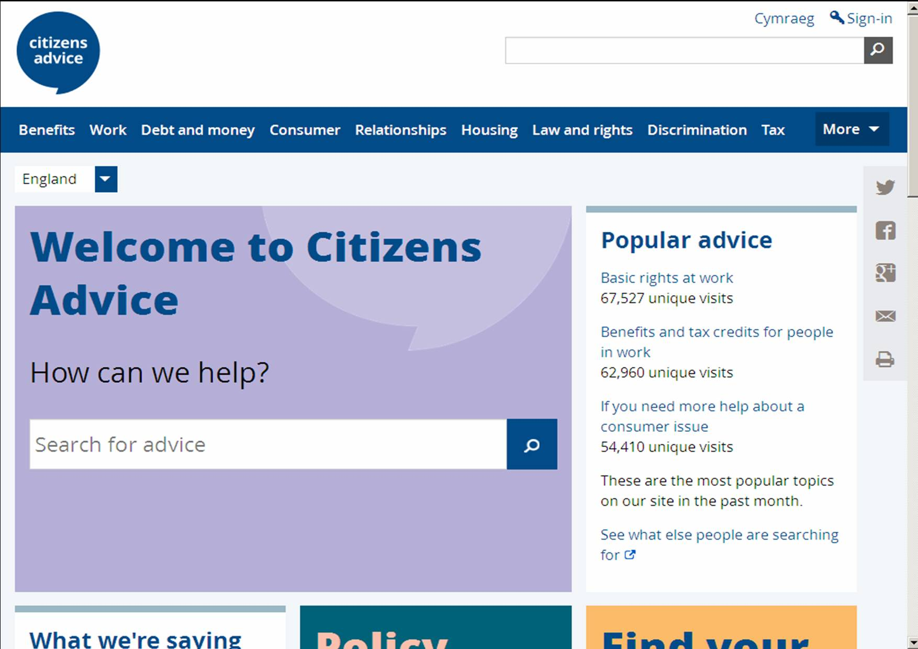

Slide 20
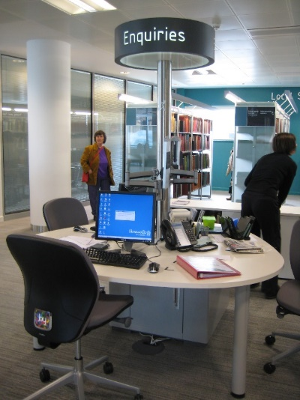
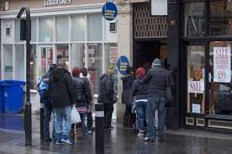


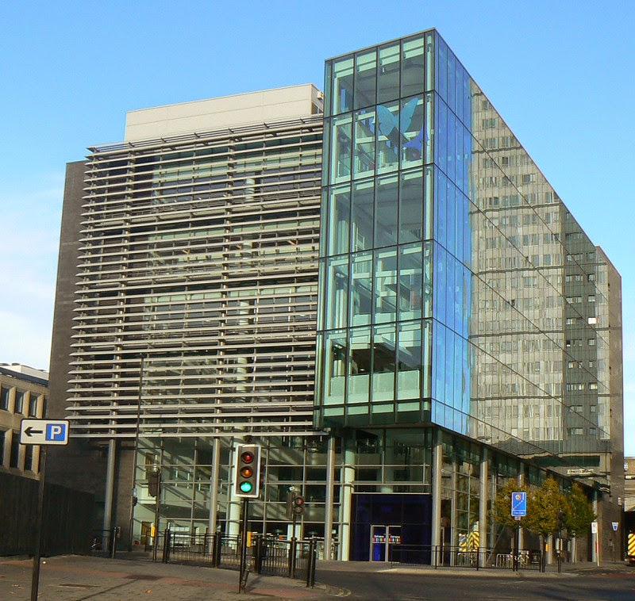
Our service transformation…..

Slide 21



Free, confidential advice. Whoever you are.
citizensadvice-newcastle.org.uk
We help people overcome their problems and campaign on big issues when their voices need to be heard.
We value diversity, champion equality, and challenge discrimination and harassment.
We’re here for everyone.
^{Citizens Advice} ^{Newcastle}
Registered charity number 1135396

Slide 22
Financial Inclusion
and Social Well Being
Shona Alexander
Chief Executive

